Slide 1

Car Price Prediction
Using Machine Learning for Automotive Valuation
A comprehensive machine learning project comparing regression models to predict vehicle prices based on specifications and market data.

Slide 2

Why Accurate Car Pricing Matters
Buying and selling vehicles requires reliable price estimation. Traditional pricing methods often lack consistency and fail to capture the complex relationships between vehicle features and market value. Machine learning provides a data-driven approach to pricing accuracy.
Make & Model
Brand reputation and vehicle segment
Year & Mileage
Age and usage impact value
Engine & Fuel
Performance and efficiency factors
Transmission
Drivetrain configuration

Slide 3
Project Objectives
This project aims to develop a predictive model that accurately estimates car prices and provides actionable insights into feature importance.
1
Build Accurate Model
2
Compare Approaches
3
Feature Analysis
Create a predictive model that minimizes prediction error across diverse vehicle types and price ranges.
Evaluate Linear Regression against Lasso Regression to identify the best balance between accuracy and generalization.
Determine which vehicle characteristics have the strongest influence on pricing decisions.

Slide 4
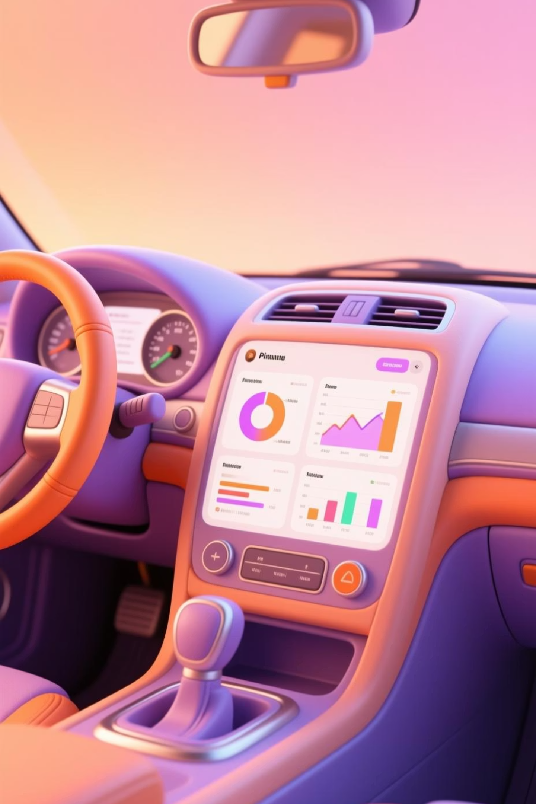
Dataset Overview
Dataset Composition
Key Features
1,002 cars – comprehensive sample
Make, model, year
Engine type, fuel type
17 features – detailed vehicle specs
Mileage, transmission
Drivetrain configuration
Target: Price (continuous variable)
Missing values were handled strategically: numeric features imputed with median values, categorical features filled with "Unknown" designation, ensuring data integrity without bias.

Slide 5

Data Preprocessing Pipeline
Careful data preparation ensures model quality and prevents bias from compromising predictions.
01
02
Remove Non-Predictive Columns
Handle Missing Values
Eliminated name and description fields as they lack predictive value.
Applied median imputation for numeric features and "Unknown" for categorical data.
03
04
Encode Categorical Variables
Scale Numeric Features
Used OneHotEncoder to convert categorical features into numeric representations.
Applied StandardScaler to normalize all numeric features to comparable ranges.

Slide 6

Model Selection & Architecture
Two regression approaches were selected to demonstrate the spectrum of model complexity and regularization strategies in price prediction.
Linear Regression
Lasso Regression
The baseline model assumes a linear relationship between features and price. It provides interpretability and establishes performance benchmarks.
Applies L1 regularization to penalize complex models, automatically performing feature selection and reducing overfitting risk.
Built-in regularization
Simple interpretation
Feature selection
Fast computation
Robust generalization
Sensitive to outliers
Both models implemented using Scikit-learn Pipelines for reproducibility and clean preprocessing workflows.

Slide 7

Training & Evaluation Methodology
A rigorous evaluation framework ensures reliable performance assessment and prevents overfitting bias.
Train-Test Split
R² Score
80% training / 20% testing
Variance explained
MAE
RMSE
Avg absolute error
Penalizes large errors
R² Score measures goodness of fit (0-1 scale). MAE provides interpretable dollar error. RMSE emphasizes larger prediction deviations, crucial for extreme price ranges.

Slide 8
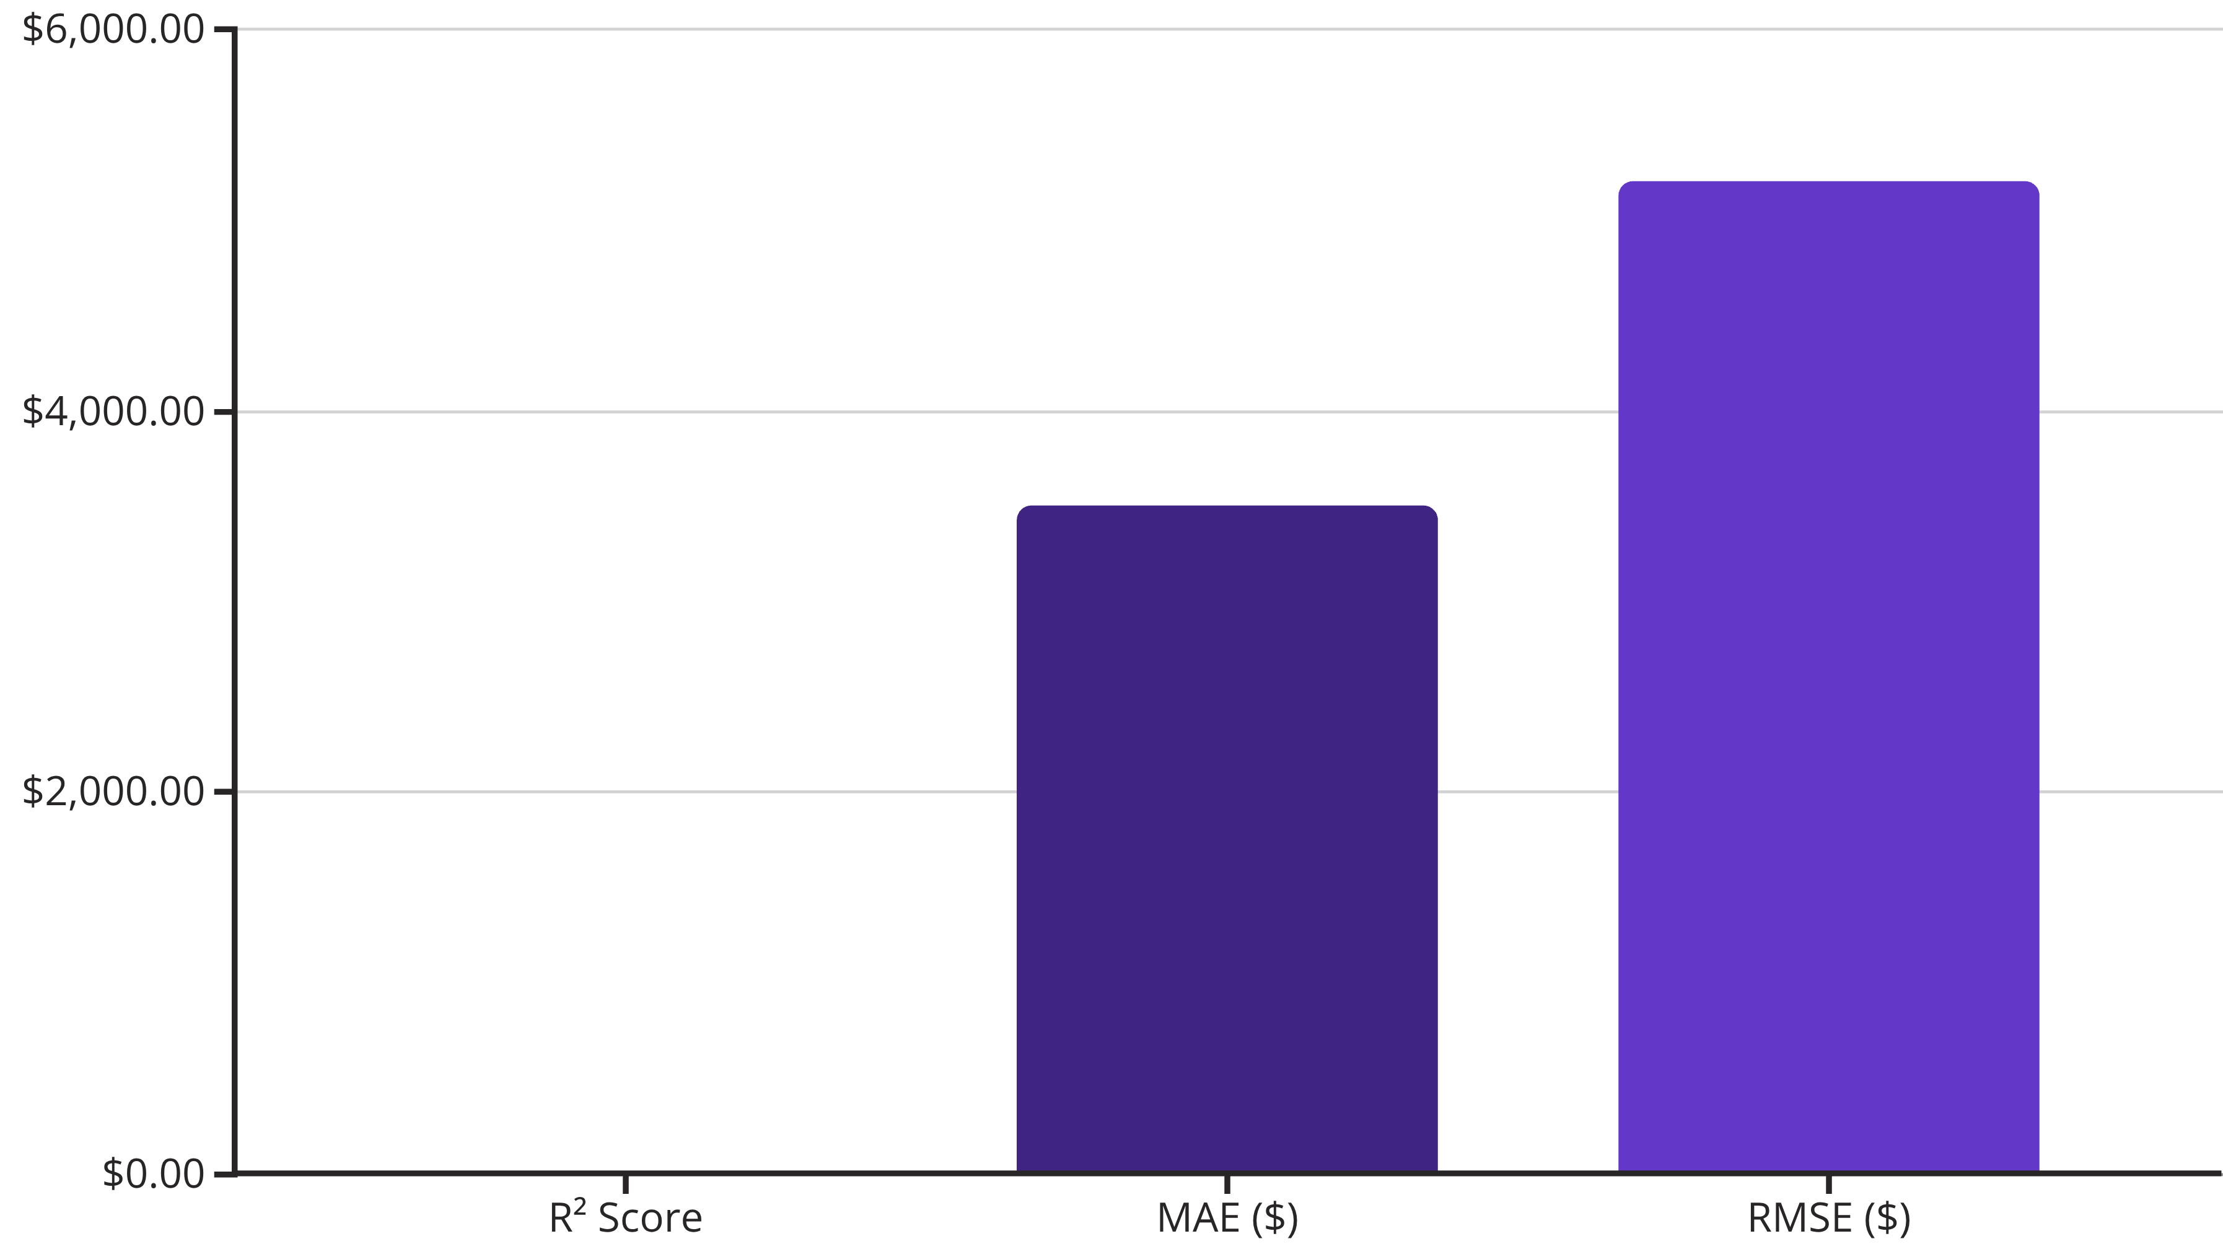
Linear Regression Results
The baseline model demonstrates solid predictive performance with good generalization across the vehicle price spectrum.
The R² score of 0.88 indicates the model explains 88% of price variance. Average prediction error of $3,500 represents reasonable accuracy for diverse vehicle segments. Slight overfitting suggests improved regularization could enhance test-set performance.

Slide 9
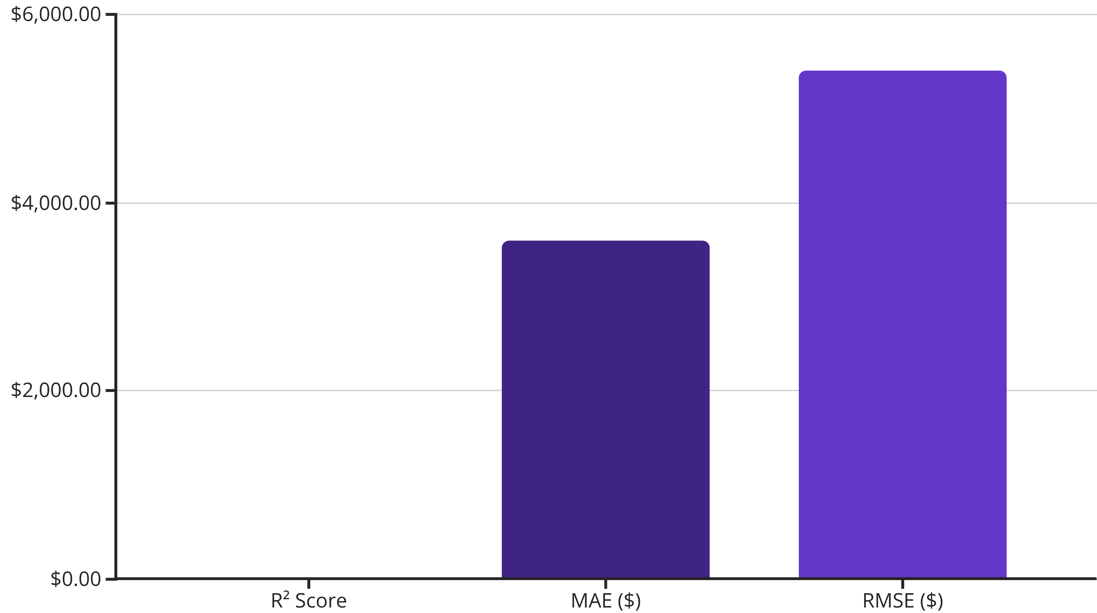
Lasso Regression Results
Regularization improves generalization by reducing model complexity and automatically selecting the most influential features.
Lasso's R² of 0.86 is marginally lower than Linear Regression, indicating a slight accuracy trade-off. However, enhanced regularization produces more stable predictions on unseen data. The model automatically eliminated less important features, improving interpretability while maintaining competitive MAE performance.

Slide 10


Actual vs. Predicted Prices
Visual validation of model accuracy through scatter plot analysis reveals prediction quality across the full price range.
Each point represents a vehicle. Points clustering along the diagonal line indicate accurate predictions. Vertical distance from the diagonal shows prediction error. Both models perform well across price ranges, with tighter clustering in mid-range vehicles ($10K-$40K) and slightly wider variance at price extremes, suggesting robust practical applicability for typical automotive transactions.
Key Insight: Linear Regression and Lasso Regression both achieve strong predictive performance. Model selection depends on priority: choose Linear Regression for maximum accuracy, or Lasso for enhanced stability and feature interpretability.

